Slide 1
Welcome to
EQ2430/EQ2435/EQ2440 Project in Wireless Communication
Lecture 1
March 20, 2015
Per Zetterberg
School of Electrical Engineering
Notes:
1

Slide 2
Agenda
Project management
Weekly reports
Reflective diary
Grading
Final report + Grand final
Selecting grand final date
github.com
Android/USRP
Groups
Go to lab: signing and handout of equipment
Notes:
2

Slide 3
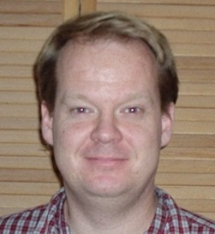

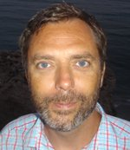
Who are we?
Per Zetterberg
Course responsible
Hadi Ghauch
Group assistant
Martin Ohlsson, Android Guru

Slide 4
What lies ahead?
Get aquinted.
Read – discuss – think – discuss
Litterature search
Read – discuss – think – discuss
Identify critical points ”is it possible to? …
Sketch of solution
Divide team into subgroups (competencies)
Write project plan
Make progress on learning android/USRP, theory, Matlab simulation, Matlab processing on measurements,
Intermediate results (critical issues?) => revise sketch of solution?
Weekly meetings, action points, follow up, diary, ….
……
Notes:
4

Slide 5
First deadline: Project Plan
April 1st
on group homepage

Slide 6
Project plan shall contain
Background (why is in interesting, what problem should be solved)
Specification (what should be achieved – goals)
Sketch of Solution (components and interactions)
Description of tasks
Allocation of people to tasks.
Time-plan (Gantt chart)

Slide 7
Top-down versus bottom-up
Top down:
Divide into subtasks.
Divide subtasks into sub-sub tasks.
Design
Implement
Bottom Up:
Learn how to compile.
Send a pulse.
Receive the pulse.
Synchronize to the pulse
…..

Slide 8
Recommendation
Follow bottom-up and top-down approaches simultaneously.
Project plan has to be top-down.
Dedicate (must)
programmers.
Algorithm/simulation/theory experts.
Project leader.
?
Let tasks run in parallel e.g. learning Android and testing algorithm.

Slide 9
Weekly meetings and progress report
Weekly meetings lead by the group leader on Wednesdays.
The project assistant(s) will also attend.
Progress reports are minutes of meeting.
Action items assigned.
Follow up against time-plan and old "action items“.
Who has done what the past week.
How many hours worked last week.
Shall be posted on the group web-site shortly after the meeting.
Notes:
9

Slide 10
Progress reports
15 April.
22 April.
29 April
6 May
13 May
20 May
27 May
Check full schedule on homepage

Slide 11
Reflective diary
Individual report, 1-2 pages.
“The students should use this diary to collect evidence of their learning with respect to the intended learning outcomes. Examples of such evidence are performance curves (with explanations), descriptions on the use of tools, or detailed descriptions of technical problems that have occurred.”

Slide 12


Reflective diary
1 April
15 April
22 April
29 April.
6 May
13 May Diary:
20 May
1 June
Dairy
Email subject line:
”[diary] number x from John Doe”
Send to:
perz@ee.kth.se
and
your assistant(s)

Slide 13
Intended learning outcomes
The students shall collaborate in teams solving a technical problem and be able to apply the theoretical knowledge acquired in previous courses. The student shall also be able to document and present the work.
In addition the students shall be able to do
Simpler forms of DSP-programming, and/or
simpler forms of PC-programming, and/or
simpler forms of programming on another platform e.g. smart-phone and/or
simpler forms of practical project management, and/or
practical algorithm development and/or
acquire knowledge for a specific application area.

Slide 14
Grades
“The grade will be determined by the students achievements in relation to the intended learning outcomes. The project assignments are designed to enforce the students to achieve the intended learning outcomes (ILOs). The success of the group (in terms of primarily the prototype and the final report) can be seen as a measure of the sum of the knowledge of the group with respect to the ILOs. In order to determine the grades of the individual students the following list of sources can be used 1) the tasks given to the student in the project plan and weekly reports 2) the success of the group in the areas where the student was active 3) the reflective diary (where the students are told to present evidence of their learning), 4) observations made by the course responsible and the assistants made in the laboratory during the course of the work. Other sources in addition to those listed may be used as well.”
Will be decided shortly after the grand-final

Slide 15
Mid-term evaluation: April 22, April 29, May 6
Matlab prototype
Android/USRP assignment
Processes real-data, collected by the smartphone/USRP
Given during android/USRP lecture

Slide 16
Final Report
Good language.
Background to the problem.
Discussion of models, fundamental limitations, previous work, literature study, etc.
Theoretical part containing description and motivation of the approach. Predicted performance.
A technical description of the prototype hardware and/or software. Design decisions should be motivated.
Performance results, compare with theory.

Slide 17
Final Prototype
Demonstrated during grand-final (PhD students, external people)
Real-time functionality.
Fulfill project specification.
Every important function compared against Matlab debugged with test harness.
Notes:
17

Slide 18
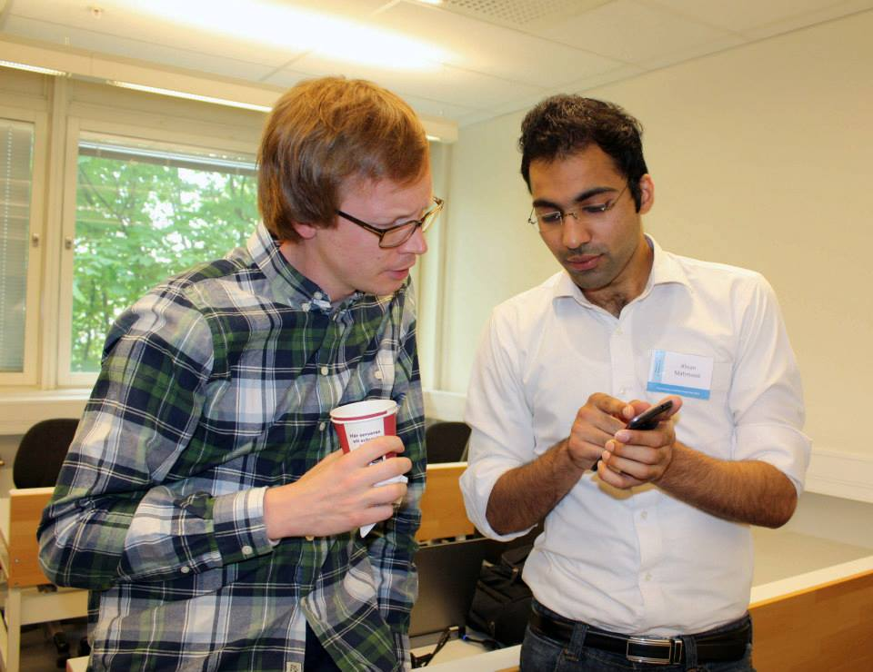
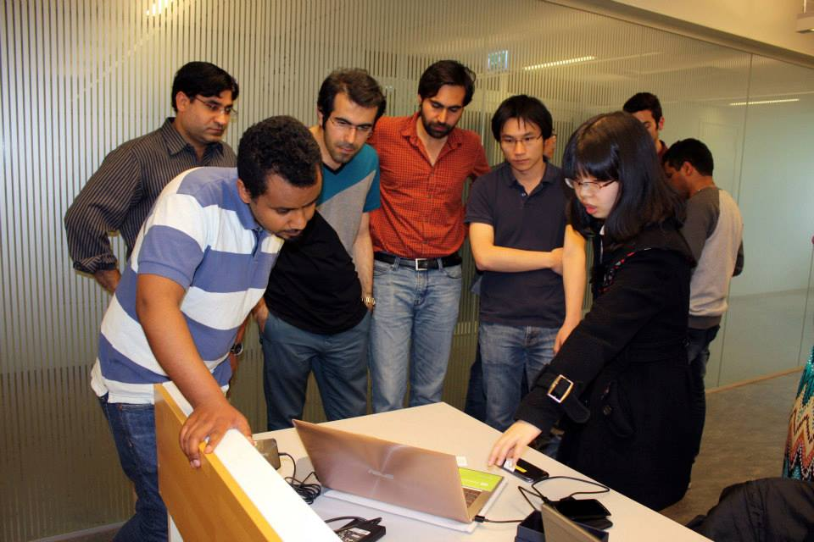
Grand-Final
Oral presentations
Demonstrations
Preliminary date: May 30th.
Proposal: 14-06-02--14-06-05

Slide 19
Code versioning system: git
Get a free account on github.com
Email me.

Slide 20
Tools
Five PCs with windows 7
Android SDK & Matlab installed
Five samsung Galaxy
Radar equipment

Slide 21
Group homepages
Create group in KTH social
https://www.kth.se/social/
Support:
https://www.kth.se/social/group/help/

Slide 23
Conclusion
Get started NOW.
Find the course homepage.
Look at your project description.
Do literature search.
Get started with the programming.
Sketch a solution
Write project plan.
Meet with your project assistants.

